Slide 1
Hangman terminal app
Safiya AIDEED

Slide 2
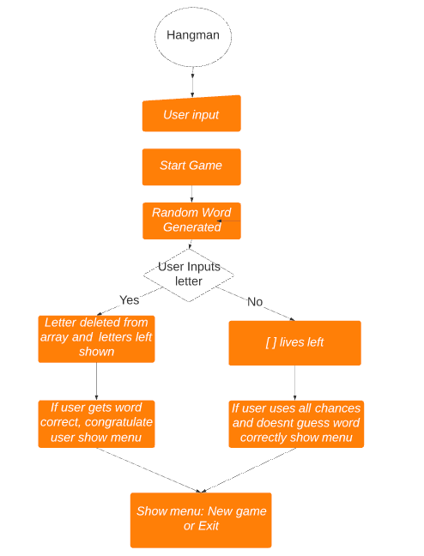
Flowchart

Slide 3
overview
Built a hangman game
A guessing game
Guess each letter of a word or a phrase
Get a certain amount of chances before losing
After losing or winning, you are met with a menu where user chooses to either start a new game or exit the game.

Slide 4
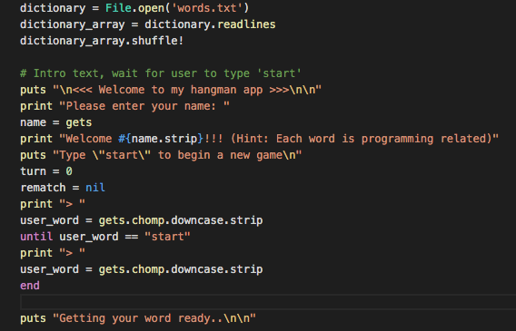
Used a text file for the dictionary instead of putting it in a string which was my initial idea
Instead of using every word in the dictionary, decided on using programming terminology specifically for the presentation, may or may not change it back to the entire dictionary
Initial idea to put the words in a string backfired, too many errors with my code.

Slide 5
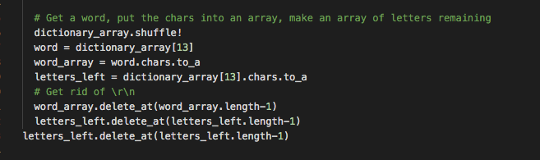
Shuffles the words so that it’s in a random order each time you play
Gets rid of letters that have already been used

Slide 6
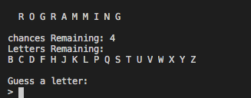
Current errors
Did not show first letter of each word on my VSCODE.

Slide 7
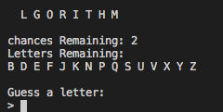
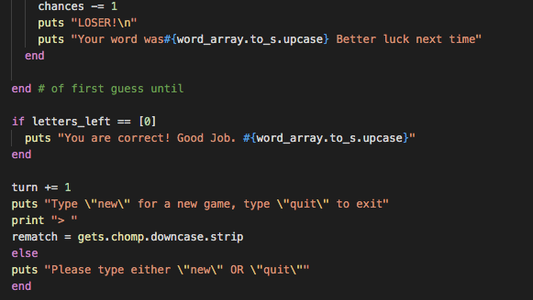
Current Errors
After the word was guessed correctly, it did not show main menu.

Slide 8
Old errors
Would not get rid of each letter in array after correct guess.
Amount of lives wouldn’t change after incorrect guess.
Wouldn’t show the last letter of each word (now the first letter disappeared lol)

Slide 9
challenges
A lot
After fixing one error another would pop up
Issue with downloading gems on my laptop

Slide 10
Thank you for listening

